Slide 1

Get Started
Wenxuan Shi
College of Software, Nankai University
Email: shiwx@nankai.edu.cn
Wechat: 13920561100

Slide 2

What is Flutter?
Flutter is Google's UI toolkit for building beautiful, natively compiled applications for mobile, web, desktop, and embedded devices from a single codebase.
Notes:
Brand-driven == customized
Internal teams at Google (CRM system) have managed to build functioning prototypes in a week.
Designers with 0 coding experiences became productive with Flutter in weeks - allowing them to build prototypes in hours.

Slide 3
Where to Start?
Website: https://flutter.dev/
Community: https://flutter.dev/community
Docs: https://flutter.dev/docs
Github: https://github.com/flutter
Showcase: https://flutter.dev/showcase
Codelabs: https://codelabs.developers.google.com/?cat=Flutter
Using Flutter in China: https://flutter.dev/community/china

Slide 4

Who's using Flutter?

Slide 5
Using Flutter in China
The Flutter community has made a Simplified Chinese version of the Flutter website available at https://flutter.cn.
If you’d like to install Flutter using an installation bundle, you can replace the domain of the original URL with a trusted mirror to speed it up. For example:
Original URL: https://storage.googleapis.com/flutter_infra_release/releases/stable/windows/flutter_windows_v1.0.0-stable.zip
Mirrored URL: https://storage.flutter-io.cn/flutter_infra_release/releases/stable/windows/flutter_windows_v1.0.0-stable.zip

Slide 6
Using Flutter in China
Configuring Flutter to use a mirror site.
$ export PUB_HOSTED_URL=https://pub.flutter-io.cn
$ export FLUTTER_STORAGE_BASE_URL=https://storage.flutter-io.cn
$ git clone -b dev https://github.com/flutter/flutter.git
$ export PATH="$PWD/flutter/bin:$PATH"
$ cd ./flutter
$ flutter doctor

Slide 7
Using Flutter in China
Community-run mirror sites: Shanghai Jiaotong University Linux User Group
FLUTTER_STORAGE_BASE_URL: https://mirrors.sjtug.sjtu.edu.cn/
PUB_HOSTED_URL: https://dart-pub.mirrors.sjtug.sjtu.edu.cn/

Slide 8
Topics
Features
Try Flutter
Install Flutter
Set up an editor
Test drive
Learn More
Notes:
Brand-driven == customized
Internal teams at Google (CRM system) have managed to build functioning prototypes in a week.
Designers with 0 coding experiences became productive with Flutter in weeks - allowing them to build prototypes in hours.

Slide 9
Features
Notes:
StatelessWidget is used for immutable elements that only rely on the object configuration information
StatefulWidget is used for elements that can dynamically change based on state-changes in the system
Everytime that state changes, setChange() is called by the object

Slide 10
Fast Development
Paint your app to life in milliseconds with Stateful Hot Reload.
Use a rich set of fully-customizable widgets to build native interfaces in minutes.

Slide 11
Expressive and Flexible UI
Quickly ship features with a focus on native end-user experiences.
Layered architecture allows for full customization, which results in incredibly fast rendering and expressive and flexible designs.

Slide 12
Native Performance
Flutter’s widgets incorporate all critical platform differences such as scrolling, navigation, icons and fonts, and your Flutter code is compiled to native ARM machine code using Dart's native compilers.
Thus Flutter gives you full native performance on both iOS and Android.

Slide 13
Try Flutter
Notes:
I’d like to concentrate on two parts of Flutter, that I especially admire

Slide 14
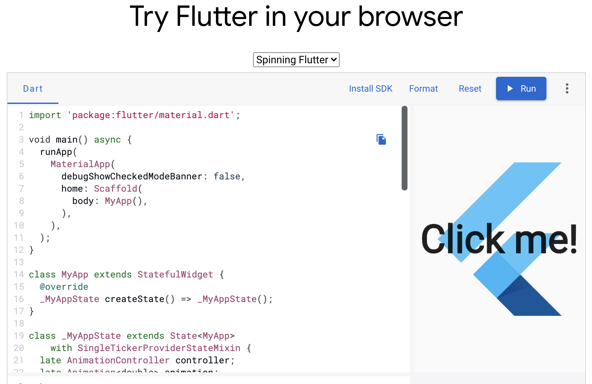
In your browser: https://flutter.dev/

Slide 15
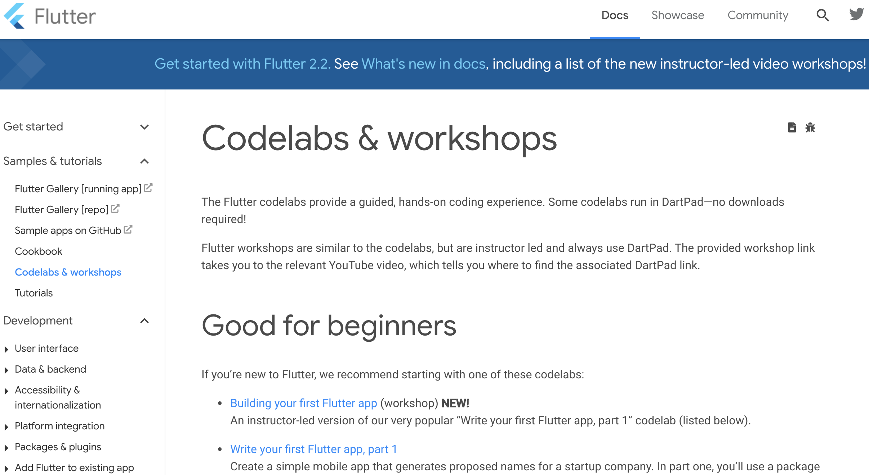
Codelabs & workshops: https://flutter.dev/docs/codelabs

Slide 16
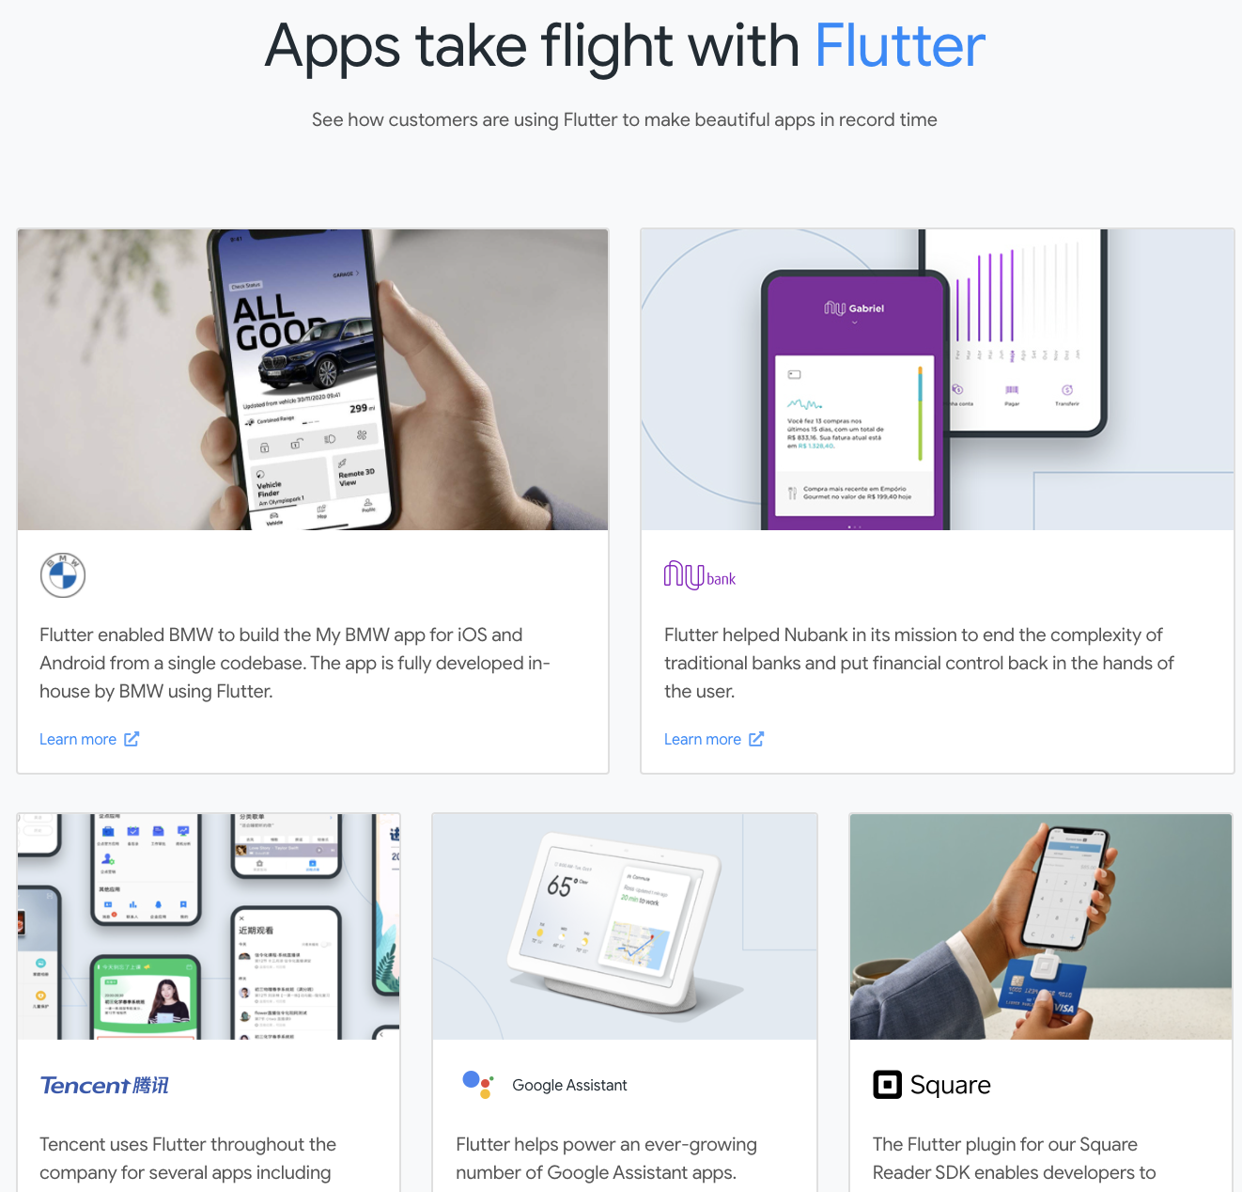
Showcase: https://flutter.dev/showcase

Slide 17
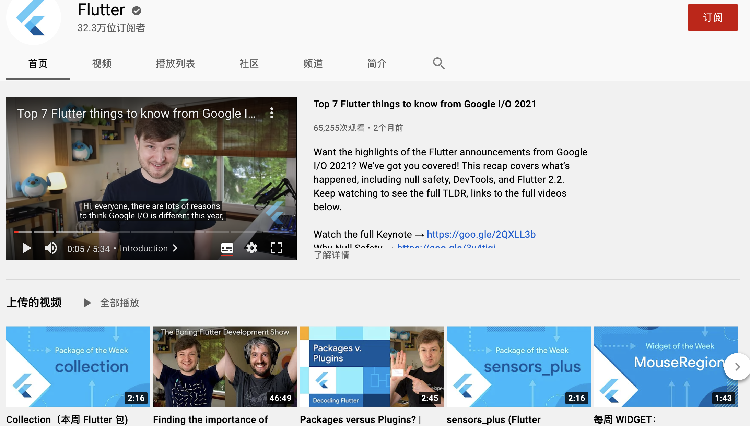
Learn from developers: https://www.youtube.com/flutterdev

Slide 18
Install Flutter It’s free and open source
Notes:
I’d like to concentrate on two parts of Flutter, that I especially admire

Slide 19
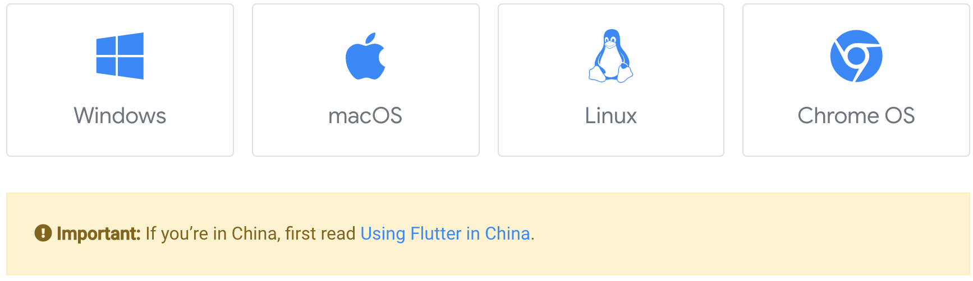
Install
Select the operating system on which you are installing Flutter:
https://flutter.dev/docs/get-started/install
https://flutter.cn/docs/get-started/install
Notes:
The beauty of hot reload is, that even after fixing an error, state is still maintained - allowing to iterate and develop far quicker.

Slide 20
Platform setup
Complete at least one of the platform setup steps now, to be able to build and run your first Flutter app.
MacOS: https://flutter.dev/docs/get-started/install/macos
Windows: https://flutter.dev/docs/get-started/install/windows
Linux: https://flutter.dev/docs/get-started/install/linux
Notes:
The beauty of hot reload is, that even after fixing an error, state is still maintained - allowing to iterate and develop far quicker.

Slide 21
Practice: Android setup
Install Android Studio
Download and install Android Studio.
Start Android Studio, and go through the ‘Android Studio Setup Wizard’. This installs the latest Android SDK, Android SDK Command-line Tools, and Android SDK Build-Tools, which are required by Flutter when developing for Android.
Run flutter doctor to confirm that Flutter has located your installation of Android Studio. If Flutter cannot locate it, run flutter config --android-studio-dir <directory> to set the directory that Android Studio is installed to.
Notes:
The beauty of hot reload is, that even after fixing an error, state is still maintained - allowing to iterate and develop far quicker.

Slide 22
Practice: Android setup
Set up your Android device
Enable Developer options and USB debugging on your device. Detailed instructions are available in the Android documentation.
Windows-only: Install the Google USB Driver.
Using a USB cable, plug your phone into your computer. If prompted on your device, authorize your computer to access your device.
In the terminal, run the flutter devices command to verify that Flutter recognizes your connected Android device. By default, Flutter uses the version of the Android SDK where your adb tool is based. If you want Flutter to use a different installation of the Android SDK, you must set the ANDROID_SDK_ROOT environment variable to that installation directory.
Notes:
The beauty of hot reload is, that even after fixing an error, state is still maintained - allowing to iterate and develop far quicker.

Slide 23
Practice: Android setup
Set up the Android emulator
Enable VM acceleration on your machine.
Launch Android Studio, click the AVD Manager icon, and select Create Virtual Device…
In older versions of Android Studio, you should instead launch Android Studio > Tools > Android > AVD Manager and select Create Virtual Device…. (The Android submenu is only present when inside an Android project.)
If you do not have a project open, you can choose Configure > AVD Manager and select Create Virtual Device…
Choose a device definition and select Next.
Notes:
The beauty of hot reload is, that even after fixing an error, state is still maintained - allowing to iterate and develop far quicker.

Slide 24
Practice: Android setup
Agree to Android Licenses
Make sure that you have a version of Java 8 installed and that your JAVA_HOME environment variable is set to the JDK’s folder.
Android Studio versions 2.2 and higher come with a JDK, so this should already be done.
Open an elevated console window and run the following command to begin signing licenses.content_copy
$ flutter doctor --android-licenses
Review the terms of each license carefully before agreeing to them.
Once you are done agreeing with licenses, run flutter doctor again to confirm that you are ready to use Flutter.
Notes:
The beauty of hot reload is, that even after fixing an error, state is still maintained - allowing to iterate and develop far quicker.

Slide 25
Practice: Android setup
Set up the Android emulator
Select one or more system images for the Android versions you want to emulate, and select Next. An x86 or x86_64 image is recommended.
Under Emulated Performance, select Hardware - GLES 2.0 to enable hardware acceleration.
Verify the AVD configuration is correct, and select Finish.
In Android Virtual Device Manager, click Run in the toolbar. The emulator starts up and displays the default canvas for your selected OS version and device.
Notes:
The beauty of hot reload is, that even after fixing an error, state is still maintained - allowing to iterate and develop far quicker.

Slide 26
Practice: Web setup
Flutter has support for building web applications in the stable channel.
Any app created in Flutter 2 automatically builds for the web.
Notes:
The beauty of hot reload is, that even after fixing an error, state is still maintained - allowing to iterate and develop far quicker.

Slide 27
Set up an editor https://flutter.dev/docs/get-started/editor
Notes:
I’d like to concentrate on two parts of Flutter, that I especially admire

Slide 28
Set up an editor
You can build apps with Flutter using any text editor combined with our command-line tools.
However, we recommend using one of our editor plugins for an even better experience.
Android Studio and IntelliJ
Visual Studio Code
Emacs
Notes:
The beauty of hot reload is, that even after fixing an error, state is still maintained - allowing to iterate and develop far quicker.

Slide 29
Practice: Android Studio
On Mac
Start Android Studio.
Open plugin preferences (Preferences > Plugins as of v3.6.3.0 or later).
Select the Flutter plugin and click Install.
Click Yes when prompted to install the Dart plugin.
Click Restart when prompted.
Notes:
The beauty of hot reload is, that even after fixing an error, state is still maintained - allowing to iterate and develop far quicker.

Slide 30
Practice: Android Studio
On Linux or Windows
Use the following instructions for Linux or WIndows:
Open plugin preferences (File > Settings > Plugins).
Select Marketplace, select the Flutter plugin and click Install.
Notes:
The beauty of hot reload is, that even after fixing an error, state is still maintained - allowing to iterate and develop far quicker.

Slide 31
Test drive https://flutter.dev/docs/get-started/test-drive?tab=androidstudio
Notes:
I’d like to concentrate on two parts of Flutter, that I especially admire

Slide 32
Test drive
Select your development tool of choice for writing, building, and running Flutter apps.
Android Studio and IntelliJ
Visual Studio Code
Terminal & editor
Notes:
The beauty of hot reload is, that even after fixing an error, state is still maintained - allowing to iterate and develop far quicker.

Slide 33
Practice: Android Studio
Create the app
Run the app
Try hot reload
Profile or release runs
Notes:
The beauty of hot reload is, that even after fixing an error, state is still maintained - allowing to iterate and develop far quicker.

Slide 34
Create the app
Open the IDE and select Create New Flutter Project.
Select Flutter Application as the project type. Then click Next.
Verify the Flutter SDK path specifies the SDK’s location (select Install SDK… if the text field is blank).
Enter a project name (for example, myapp). Then click Next.
Click Finish.
Wait for Android Studio to install the SDK and create the project.
Notes:
Also available via IntelliJ’s built-in debugger

Slide 35
Run the app
Locate the main Android Studio toolbar:
In the target selector, select an Android device for running the app. If none are listed as available, select Tools> Android > AVD Manager and create one there.
Click the run icon in the toolbar, or invoke the menu item Run > Run.
Notes:
Also available via IntelliJ’s built-in debugger

Slide 36
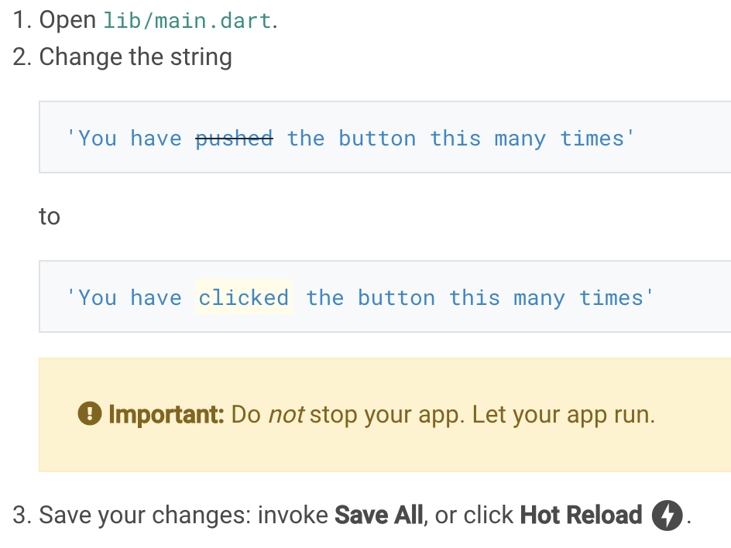
Try hot reload
Flutter offers a fast development cycle with Stateful Hot Reload, the ability to reload the code of a live running app without restarting or losing app state.
Notes:
Also available via IntelliJ’s built-in debugger

Slide 37
Profile or release runs
So far you’ve been running your app in debug mode.
Debug mode trades performance for useful developer features such as hot reload and step debugging.
Once you are ready to analyze performance or release your app, you’ll want to use Flutter’s “profile” or “release” build modes.
For more details, see Flutter’s build modes.
Notes:
Also available via IntelliJ’s built-in debugger

Slide 38
Learn More
Notes:
I’d like to concentrate on two parts of Flutter, that I especially admire

Slide 39
Flutter basics
Introduction to widgets
Building layouts tutorial
Add interactivity tutorial

Slide 40
Apply your existing knowledge
Flutter for Android developers
From Java to Dart codelab
Flutter for iOS developers
Flutter for React Native developers
Flutter for web developers
Flutter for Xamarin.Forms developers

Slide 41
Other resources
Flutter samples
Flutter cookbook
Bootstrap into Dart: learn more about the language
Flutter API Docs
The Complete Flutter Developer Bootcamp Using Dart
Udacity online Flutter training

Slide 42
Thank you!
Wenxuan Shi
College of Software, Nankai University
Email: shiwx@nankai.edu.cn
Wechat: 13920561100

